Slide 1
Bladder Cancer
Savita
6-26-19
5-11-21

Slide 2
Bladder Cancer
UK Trial BC2001 (James ND et al NEJM 2012)
Current NRG trial: NRG GU001
Baumann BC, Bosch WR, Bahl et al Red Journal 2018 (adjuvant radiation consensus contouring guidelines)
Baumann, He, Hwang adjuvant radiation paper
Coen JJ, Zhang P, Saylor PJ RTOG 0712. BID radiation
Efstathiou JA, Spiegel DY et al eur urol 2012
Mak RH, Hunt D, Shipley WU : pooled RTOG analysis
Mitin, Hunt, Shipley RTOG 0233
Rodel, Grabenbauer GG, Kuhn R et al 2002 – another longterm bladder preservation study
Shipley WU, Prout Cancer 1987
Weiss, Wolze, Engehausen, Ott et al high risk T1 bladder cancer
Zaghloul MS, Christodouleas JP, Smith et al Red Journal 2018

Slide 3
RTOG Trials
8903
9506
9706
9906
0233
BC2001 5FU/MMC/55Gy/20fx
0712
BCON carbogen and niacinamide

Slide 4
Epidemiology
Per year: 69,250 new cases in US (2011 ACS estimate); 14,990 deaths
Average age 73 y/o; M:F 3:1 (4th most common ca in US men)
Risk Factors:
Smoking
Chemical exposure (dyes, rubber, plastics)
Chronic irritation (UTI, catheterization, Schisto)
Cytoxan
Histology: Urothelial carcinoma most common (>97%), squamous, or adenocarcinoma rare
On initial diagnosis:
70-75% non-muscle invasive (superficial)
20-25% muscle-invasive
5% metastatic
Notes:
4
50% of US cases linked to smoking, correlates to number of pack years, cytogenetic studies suggest related to p53 overexpression.
Chemicals: aromatic amines, 2- napthylamine (hair dye, rubber) and benzidine (hair dye, paint). Rubber, leather, printing materials, textiles, and paint products
33% T4, 72%T2
Primary goal is cure, secondary goal is preserving tumor-free bladder without compromising survival

Slide 5
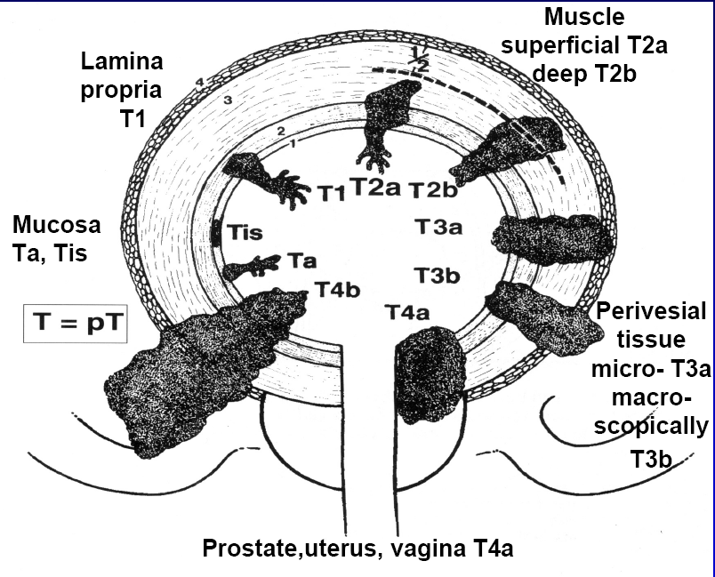
Bladder T-stage
Pelvic or abd wall
Notes:
Bladder T3 and T4 have very high risk of local recurrence so NRG GU001 is a trial of adjuvant radiation

Slide 6
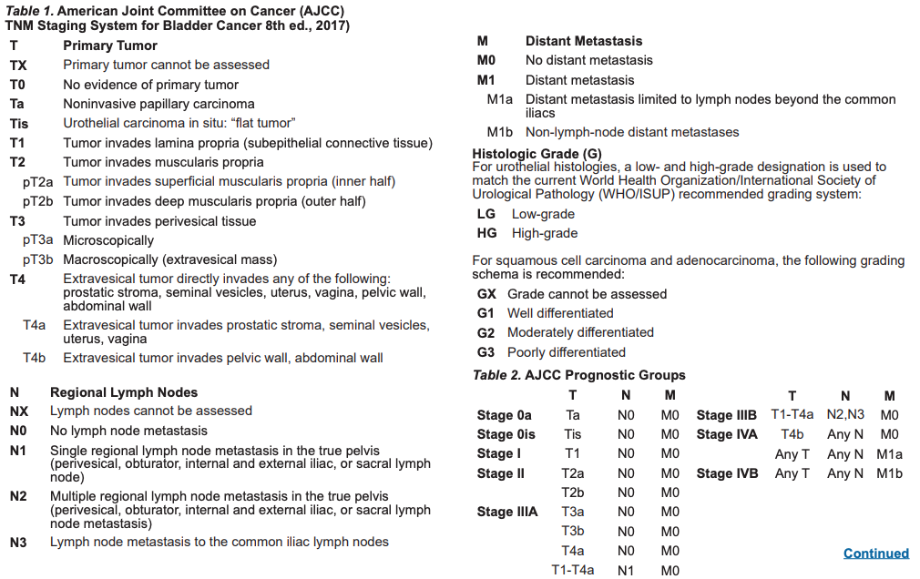

Slide 7
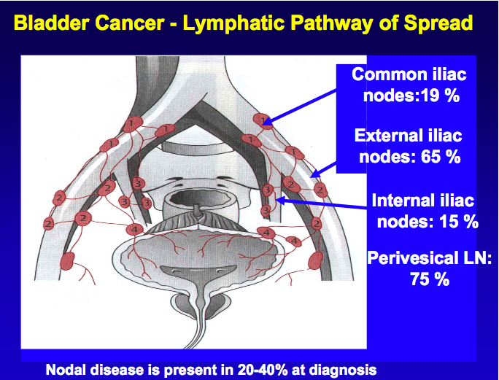

Slide 8
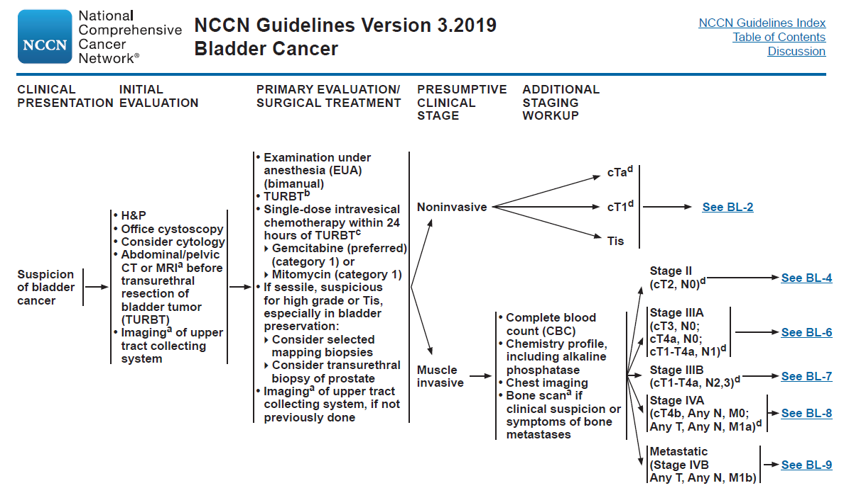

Slide 9
History
Characterize sxs:
**PAINLESS Hematuria (75%)
Irritative voiding (25-30%)
Pelvic pain
Back pain
Risks:
Chemical exposure
Tobacco - increases risk 2-3x
Aromatic amines, aniline dyes, and nitrites and nitrates (e.g. leather industry workers)
Cyclophosphamide
Chronic irritation – squamous cell carcinoma
Indwelling catheters
Schistosoma haematobium
Pelvic RT
Urachal remnant - adenocarcinoma

Slide 10
Physical Exam:
Abdominal exam
Pelvic exam for females
CVA Tenderness
LNs
Penile/Testicular Exam for men
Rectal Exam

Slide 11
Labs:
Urinalysis, Urine cytology (detects 50-80% poorly diff; only 20% well diff)
CBC, chemistries with renal function, LFTs, alk phos, coags
Office cystoscopy
Evaluation of upper tract with: CT urography, IVP, retrograde pyelogram, ureteroscopy, MRI urogram
If presumed muscle invasive based on office cystoscopy (solid/sessile, high grade, “suggests muscle invasion) then:
CT Chest/Abdomen/Pelvis (done in conjunction with CT Urogram).
Bone scan in alk phos high or symptoms
EUA (bimanual exam to determine if cT3); maximal TURBT, bladder mapping, & biopsies of bladder & prostatic urethra if the lesion is in the trigone; adequate muscle must be taken.
Notes:
Realistically start with CT. Presumed muscle invasive based on office cystoscopy, primarily size. Bimanual exam – EUA, rectal exam + pushing on abdomen. Feel fat plane surrounding bladder to see if there is any tethering. MUST RETROFLEX SCOPE to ensure that nothing is missed.

Slide 12
Bladder Cancer – Via Oncology 2021
Treatment post Radical cystectomy – no defined pathway (we will discuss papers)
Ta, Tis, T1
Urology
T2-T4aN0 (if cystectomy candidate)
either neoadjuvant chemo/cystectomy or concurrent chemort
45Gy → IMRT bladder 60-65Gy
T2-T4aN0 (T4b same just induction chemo first) (if not cystectomy candidate)
Chemort. Bladder only 50-55Gy/2.5Gy/fx
Conventional: 60-65Gy
N+
Conventional: 60-65Gy, treat nodes, could consider boost to nodes
Bladder mets
30Gy/10fx

Slide 13
T2 Tumors and bladder preservation chemoXRT
Relative contraindications…
hydronephrosis
>6cm
multifocal Tis
Not maximally debulked by TURBT (incomplete TURBT worse)
ureteral orifice obstruction
Poor bladder function

Slide 14
BC2001 (James NEJM 2014)
2x2
XRT alone vs. 5FU/MMC+XRT
**cisplatin not chosen b/c these were non surgical candidates tended to have poor renal function as well or risk
2nd RCT was standard whole bladder xrt vs. reduced volume higher dose XRT (strt vs. rhdvrt)
T2-T4aN0M0
Primary: LRC
Conclusion:
2yr LRC survival 54% vs. 67% (10-15% benefit of chemo)
5yr OS only trend 35% vs. 48%
Acute toxicity slight trend but no change in late toxicity ~30% toxicity rate

Slide 15
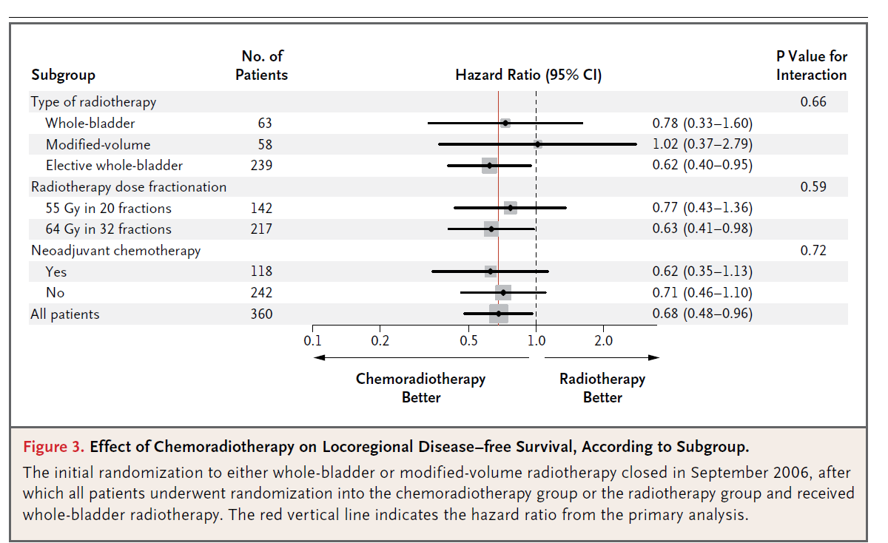
BC2001 UK Study
The modified bladder was stopped because no benefit so only 16% of pts in study 60pts small no.
Most received 64Gy/32fx (60% of patients vs. hypofx)
5FU 500mg/m2
MMC 12mg/m2
Min age >65yo
Only 56% had complete TURBT

Slide 16
BC2001 (Hall JCO 2017 abstract)
Extended follow-up
10years
Still see local control benefit and salvage cystectomy benefit
Salvage cystectomy 17% vs. 11% (so about 6% benefit of chemo)
This long-term followup shows that bladder preservation trimodality treatment works! (TURBT, chemo-radiation)

Slide 17
BC2001 – pooled analysis
55Gy/20 or 64Gy/32fx
Hypofractionated radiotherapy in locally advanced bladder cancer: an individual patient data meta-analysis of the BC2001 and BCON trials
55Gy/20fx noninferior to standard fractionation.
700+patients
Invasive locoregional control and toxicity
Superior for locoregional control (HR 0.71)
55Gy/20fx standard of care locally advanced bladder cancer (N0)

Slide 18
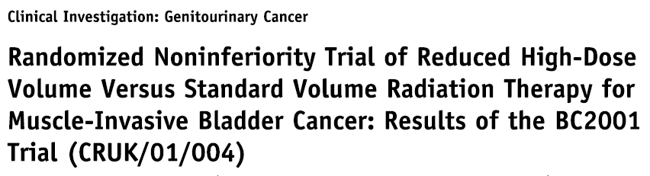
Another option for bimodality (chemoRT)
Standard RT (Control): PTV was outer bladder wall plus extravesical extent of tumor + 1.5cm. Used anterior and 2 lateral fields to encompass PTV in 95% isodose line. Treated to 64 Gy in 2 Gy fractions (could also use 55 Gy in 20 fractions).
Reduced Volume (Experimental): PTV1 was same as standard RT. PTV 2 was gross tumor volume (as seen on MRI/CT with guidance of surgical bladder map) plus 1.5 cm. 100% of prescribed dose to PTV 2 and 80% to PTV 1.

Slide 19
Background – how did we get to the BC2001
RTOG 9506
Phase I
5FU/Cisplatin XRT for bladder preservation/trimodality treatment
RTOG 0233
Randomized phase II
Cisplatin based XRT BID
0233 more or less became standard until 0712
Then 0712 became standard

Slide 20
RTOG 0233 Mitin et al 2013
TURBT
Cis/paclitaxel XRT
Cis/5FU XRT
Phase II RCT
cT2-T4a
Induction 40.3Gy BID
If response almost CR: To-Ta then consolidative xrt to 64Gy
Adjuvant cis/gem/paclitaxel
Only 70% completed all treatment
97pts, 93 analyzed
Conclusion: any cis based chemo regimen okay (**but the worry on renal function)

Slide 21
Pooled RTOG analysis (Mak, Shipley et al JCO 2014)
RTOG studies
8802, 8903, 9506, 9706, 9906, 0233 (before bc2001 and before 0712)
Only 8903 phase III, rest phase II
MIBC
cT2-T4a
No LN, no mets
61% T2
35% T3
4% T4a
5yr OS 60%, DSS 70%, MIBC LF 10-15% (NMIBC actually 30%!), Mets 30%
10yr OS 40%, DSS 65%, MIBC LF 10-15%, (NMIBC actually 30%!), Mets 35%
5yr bladder intact (for survivors) 80%

Slide 22
RTOG 0712 (Coen, Shipley et al JCO 2019)
2008-2014 , 70 pts enrolled in 6 years! 66pts analyzable (10 centers!)
5FU/Cisplatin + XRT BID
Gemcitabine low dose + XRT QD
cT2-T4a (****97% cT2, 3% cT3-T4a)
Primary: DMFS at 3 yrs >75%
Induction chemoxrt CR: 88% BID, 78% QD
DMFS at 3 yrs 67% BID, 72% QD
6% grade 4
55-60% grade 3 toxicity (55% QD, 64% BID)
Favor QD for less toxicity but either regimen recommended…
FOR THE RTOG TRIALS 40Gy then break for 3-4 weeks do repeat cystoscopy – if CR then boost to 64Gy. If NO CR then cystectomy (this is unlike the BC2001 UK Study)

Slide 23
RTOG 0712 Radiation plan!
TURBT → Induction CRT → 3-4 weeks → check if CR → CR do consolidative CRT → 3 months later →adjuvant chemo gem/cis
BID unusual!
1.6Gy AM (pelvis) x 13 fractions
1.5Gy PM whole bladder x 5 fractions
1.5Gy PM bladder tumor x 8 fractions
BID: 20.8Gy pelvis/28.3Gy Bladder/ 40.3Gy bladder tumor
QD also unusual!
40Gy/2Gy
20Gy to pelvis/28Gy bladder/40Gy bladder tumor
Consolidative:
1.5Gy x 8fractions pelvis BID
2Gy x 12fractions pelvis QD

Slide 24
Chemo
Old RTOG: 5FU/Cisplatin
RTOG 0233 cisplatin/paclitaxed
BC2001 5FU/MMC
RTOG 0712 low dose gemcitabine
Adjuvant chemo sometimes…. Gemcitabine/cisplatin
Notes:
--Simulate patient with full and empty bladder in supine position with/without IV contrast. If doing cone down boost method, use empty bladder for whole bladder tx and full bladder for the boost tx.
--→RTOG 0712 approach (for contouring): CTV pelvis/CTV bladder/CTVboost. CTV pelvis is a small pelvic field historically (because of trying to preserve bowel in case of salvage surgery), starting at S2-S2 and extending inferiorly below obturator foramen, CTV bladder is whole bladder, and CTV boost is gross tumor. Used four fields with 2 cm margin on each CTV for the various cone-downs. The fractionation is complicated and may not be needed to get into the nitty gritty, but on this trial would generally deliver 20 Gy to pelvis/then 8 Gy to bladder/then 12 Gy to boost-→break for eval→then 24 Gy to pelvic field (for total doses of 44/52/64 Gy)
--→BC2001 approach (for contouring): PTV=(bladder+extravesical tumor)+1.5 cm for whole bladder // PTV=GTV+1.5 cm for partial bladder high dose target [however, even in partial bladder arm, the whole bladder field is still drawn and gets 80% of rx dose
--→Simple approach would be to just treat whole bladder field (assume no nodes) to 50 Gy, then boost a partial bladder volume to 64 Gy
➔Final doses are either 64 Gy in 2 Gy fx (RTOG, BC2001) or 55 Gy in 2.75 Gy fx
→Chemo regimens include 5-FU/Cis (old RTOG regimens with bid rt), cisplating/paclitaxel (RTOG 0233), 5-FU/MMC (BC2001), weekly gemcitabine (RTOG 0712 experimental)
-→Cystoscopy at 4-6 weeks, then q3 months for two years, and then q6 months yrs 3-5, then qyear.
Followup per NCCN: at 2-3 months, imaging with full CT of c/a/p with contrast, w/ or w/o bone scan.

Slide 25
SWOG/NRG 1806 Efstathiou planned trial
Same as all tumors – add immunotherapy and see what happens
Atezolizumab
Qday radiation
Any reasonable chemo concurrent allowed
NO MORE mid treatment assessment at 40Gy (similar to BC2001)

Slide 26
Radiation Therapy Fields for Bladder Preservation

Slide 27
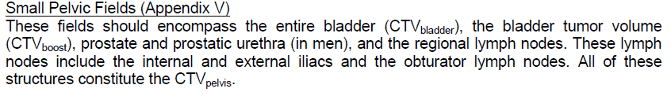
Bladder Initial Fields
Simulate with Empty bladder; supine; vac-lock OR with aquaplast cast over pelvis.
45 Gy in 1.8 Gy fractions.
AP:
Superior: mid-SI; top of S2
Inferior: bottom of obturator foramen
Lateral: 2 cm pelvic brim
block femoral heads
Lat: anter/inf.
Anterior: 2-3 cm margin on ant. bladder wall
Post: 2-3 cm margin on post. bladder wall
Corner block under symphysis
Corner block ant/sup. to block bowel anterior to ext. iliac LN group
block posterior rectum and entire anal canal
Notes:
40 Gy to pelvis, 60-64 to tumor. ALL 3D. No IMRT.
Contour Prostate because prostatic urethra must be included.

Slide 28
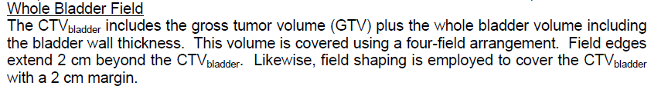
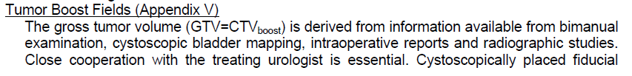
Boost Fields
Lats or 3D CRT
Use surgeon’s map & MRI for details of location +/- fiducials
Empty Bladder + 2 cm to field edge to 54 Gy
Then, tumor + 2 cm to field edge margin to 64.8 Gy

Slide 29
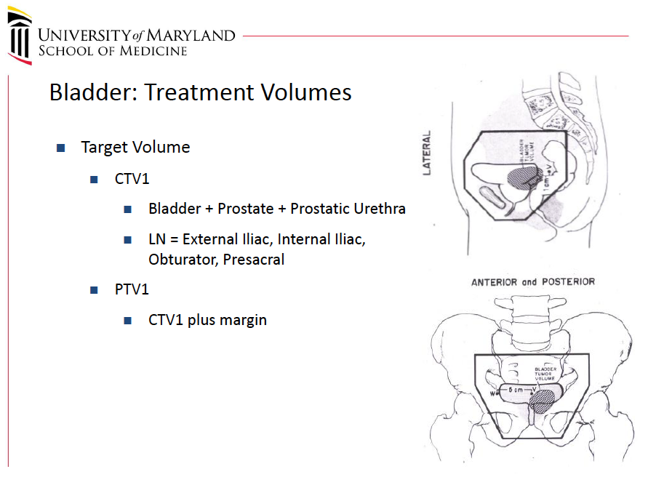

Slide 30
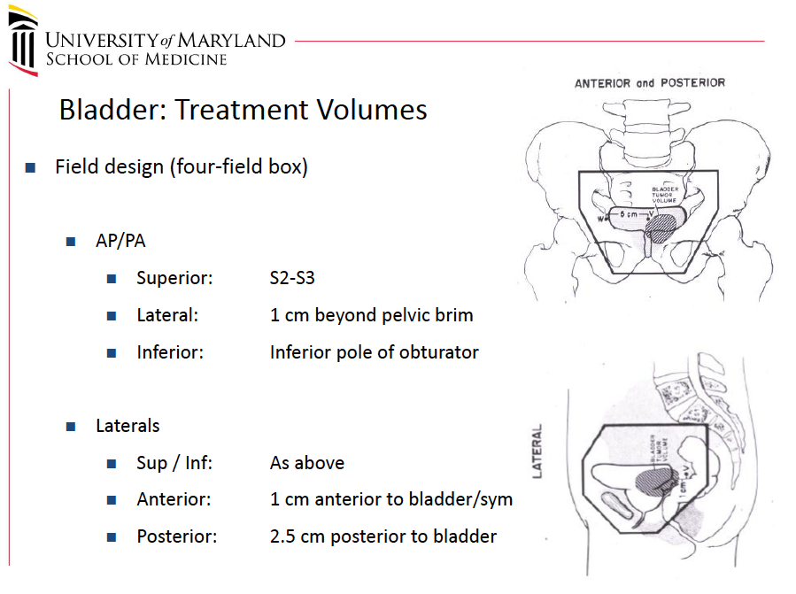

Slide 31
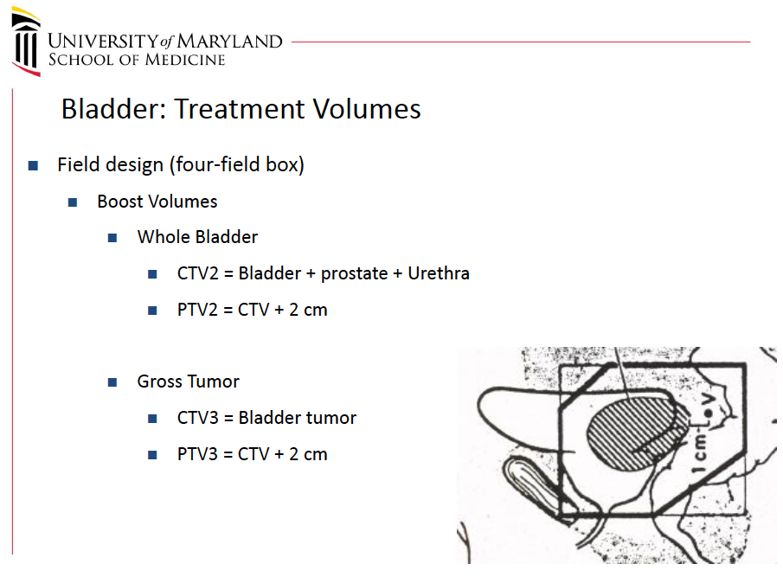

Slide 32
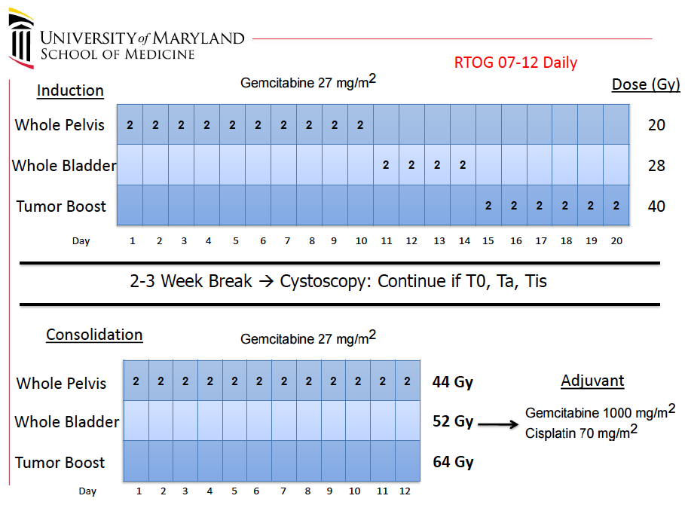

Slide 33
Other Options
45 Gy in 1.8 Gy to Bladder+LNs
Skip whole bladder component and just cone-down to tumor to 64.8 Gy

Slide 34
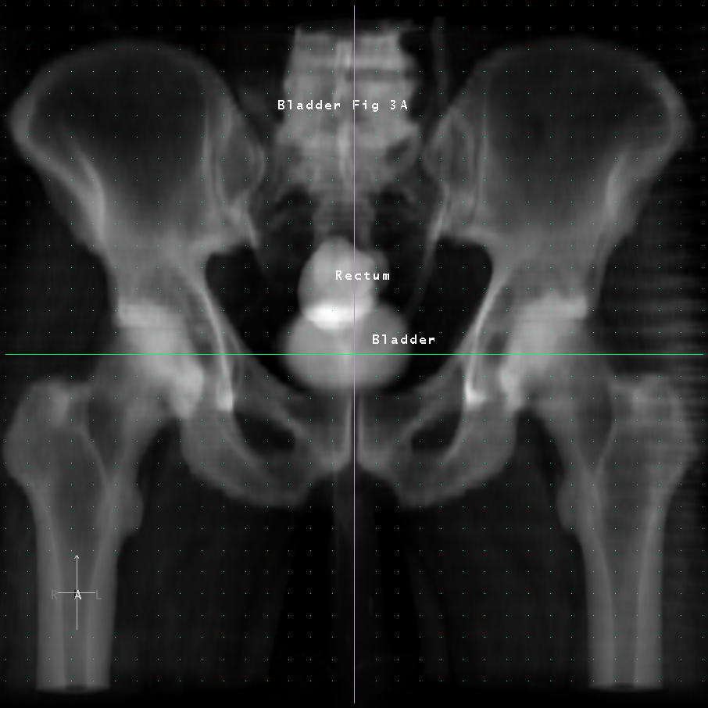
Draw your fields.

Slide 35
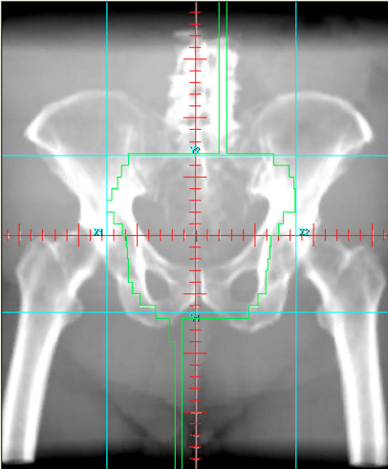
Small Pelvis

Slide 36
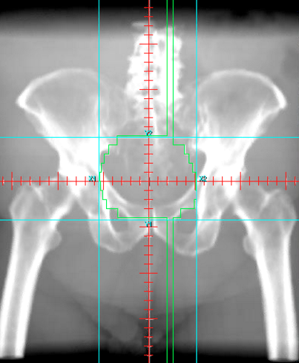
Whole Bladder

Slide 37
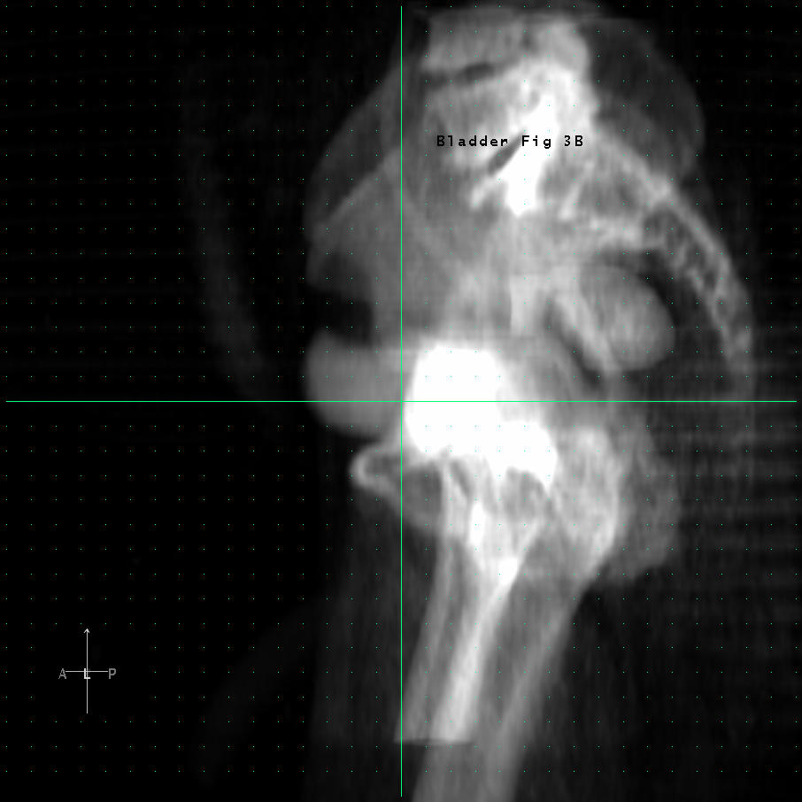

Slide 38
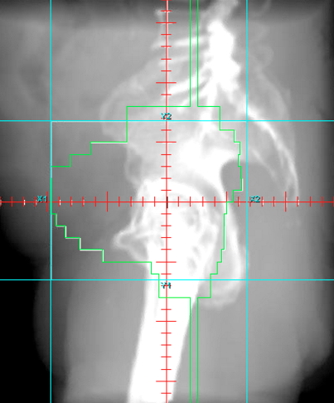
Small Pelvis

Slide 39
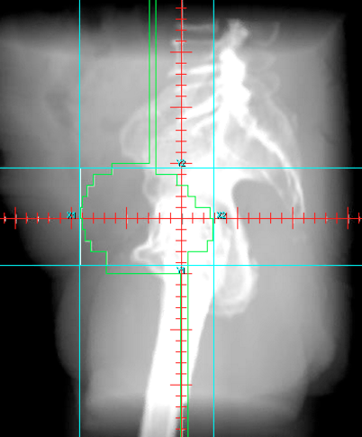
Whole Bladder

Slide 40
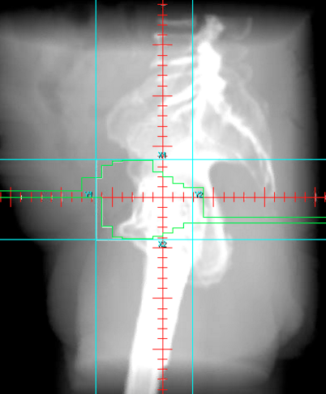
Tumor Boost

Slide 41
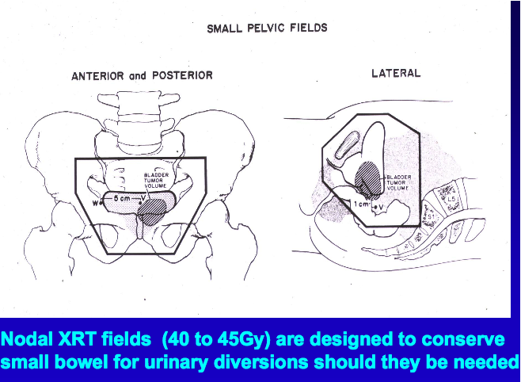

Slide 42
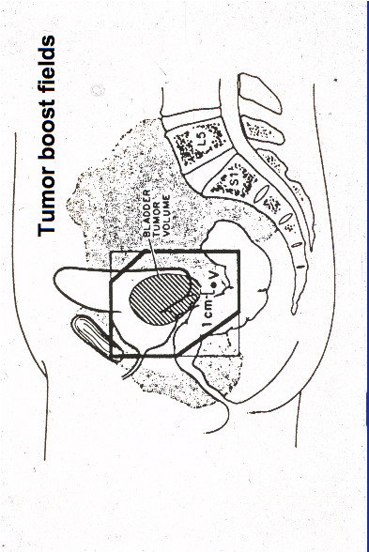

Slide 43
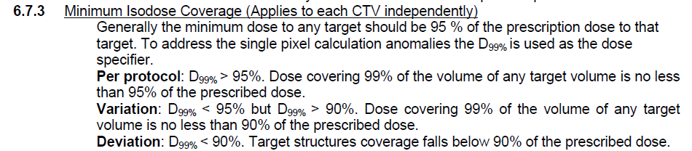
Dose Constraints (RTOG 0712)
Rectum
V30 <50%
V55 <10%
Femoral heads
V50 <20%

Slide 44
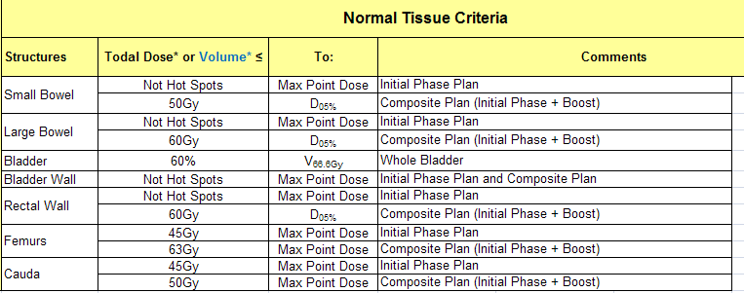
Dose Constraints (MSKCC)

Slide 45
Another option for bimodality (chemoRT)
Standard RT (Control): PTV was outer bladder wall plus extravesical extent of tumor + 1.5cm. Used anterior and 2 lateral fields to encompass PTV in 95% isodose line. Treated to 64 Gy in 2 Gy fractions (could also use 55 Gy in 20 fractions).
Reduced Volume (Experimental): PTV1 was same as standard RT. PTV 2 was gross tumor volume (as seen on MRI/CT with guidance of surgical bladder map) plus 1.5 cm. 100% of prescribed dose to PTV 2 and 80% to PTV 1.

Slide 46
CT Simulation
Empty bladder for first part 40-50.4Gy
Boost tumor – some say just treat empty bladder and just treat almost all bladder (80% of dose to the uninvolved bladder if can separate)
Boost tumor If localized tumor – some say do full bladder and localize the TURBT site with fiducials (spare bowel more)
Notes:
--Simulate patient with full and empty bladder in supine position with/without IV contrast. If doing cone down boost method, use empty bladder for whole bladder tx and full bladder for the boost tx.
--→RTOG 0712 approach (for contouring): CTV pelvis/CTV bladder/CTVboost. CTV pelvis is a small pelvic field historically (because of trying to preserve bowel in case of salvage surgery), starting at S2-S2 and extending inferiorly below obturator foramen, CTV bladder is whole bladder, and CTV boost is gross tumor. Used four fields with 2 cm margin on each CTV for the various cone-downs. The fractionation is complicated and may not be needed to get into the nitty gritty, but on this trial would generally deliver 20 Gy to pelvis/then 8 Gy to bladder/then 12 Gy to boost-→break for eval→then 24 Gy to pelvic field (for total doses of 44/52/64 Gy)
--→BC2001 approach (for contouring): PTV=(bladder+extravesical tumor)+1.5 cm for whole bladder // PTV=GTV+1.5 cm for partial bladder high dose target [however, even in partial bladder arm, the whole bladder field is still drawn and gets 80% of rx dose
--→Simple approach would be to just treat whole bladder field (assume no nodes) to 50 Gy, then boost a partial bladder volume to 64 Gy
➔Final doses are either 64 Gy in 2 Gy fx (RTOG, BC2001) or 55 Gy in 2.75 Gy fx
→Chemo regimens include 5-FU/Cis (old RTOG regimens with bid rt), cisplating/paclitaxel (RTOG 0233), 5-FU/MMC (BC2001), weekly gemcitabine (RTOG 0712 experimental)
-→Cystoscopy at 4-6 weeks, then q3 months for two years, and then q6 months yrs 3-5, then qyear.
Followup per NCCN: at 2-3 months, imaging with full CT of c/a/p with contrast, w/ or w/o bone scan.

Slide 47
RTOG 0712/US Protocol
Small Pelvic Fields: CTV_{pelvis} includes CTV_{bladder} (2 cm expansion of bladder), prostate and prostatic urethra, and nodes (II, EI, obturator). Use 4 fields (AP/PA and opposed lats), with bladder empty
AP/PA: mid-sacrum (anterior aspect of S2-S3) to bottom of obturator pole Laterally, extend 1.5 cm beyond widest point of the bony margin.
Lats: Ant and post boundaries are 2 cm beyond the “CTV_{pelvis}”
These are treated with bladder empty.
IMRT was not allowed on this trial due to concerns about missing!
Notes:
--Simulate patient with full and empty bladder in supine position with/without IV contrast. If doing cone down boost method, use empty bladder for whole bladder tx and full bladder for the boost tx.
--→RTOG 0712 approach (for contouring): CTV pelvis/CTV bladder/CTVboost. CTV pelvis is a small pelvic field historically (because of trying to preserve bowel in case of salvage surgery), starting at S2-S2 and extending inferiorly below obturator foramen, CTV bladder is whole bladder, and CTV boost is gross tumor. Used four fields with 2 cm margin on each CTV for the various cone-downs. The fractionation is complicated and may not be needed to get into the nitty gritty, but on this trial would generally deliver 20 Gy to pelvis/then 8 Gy to bladder/then 12 Gy to boost-→break for eval→then 24 Gy to pelvic field (for total doses of 44/52/64 Gy)
--→BC2001 approach (for contouring): PTV=(bladder+extravesical tumor)+1.5 cm for whole bladder // PTV=GTV+1.5 cm for partial bladder high dose target [however, even in partial bladder arm, the whole bladder field is still drawn and gets 80% of rx dose
--→Simple approach would be to just treat whole bladder field (assume no nodes) to 50 Gy, then boost a partial bladder volume to 64 Gy
➔Final doses are either 64 Gy in 2 Gy fx (RTOG, BC2001) or 55 Gy in 2.75 Gy fx
→Chemo regimens include 5-FU/Cis (old RTOG regimens with bid rt), cisplating/paclitaxel (RTOG 0233), 5-FU/MMC (BC2001), weekly gemcitabine (RTOG 0712 experimental)
-→Cystoscopy at 4-6 weeks, then q3 months for two years, and then q6 months yrs 3-5, then qyear.
Followup per NCCN: at 2-3 months, imaging with full CT of c/a/p with contrast, w/ or w/o bone scan.

Slide 48
RTOG 0712/US Protocol
Boost Fields: The tumor volume is derived from clinical information, ideally with fiducials. Classically used opposed laterals, but 0712 states that variety of field arrangements are permitted so long as a 2 cm margin around the GTV is covered. It does note that efforts should be taken to minimize dose to uninvolved bladder.
These don’t have to be treated with bladder full, though sometimes contrast is given to enhance visibility
CTVPelvis: Gets 44 Gy. Fields are 2 cm from this
CTVBladder: Gets 52 Gy. Fields are 2 cm from this (80%)
CTVBoost: Gets 64 Gy. Fields are 2 cm from this
Notes:
--Simulate patient with full and empty bladder in supine position with/without IV contrast. If doing cone down boost method, use empty bladder for whole bladder tx and full bladder for the boost tx.
--→RTOG 0712 approach (for contouring): CTV pelvis/CTV bladder/CTVboost. CTV pelvis is a small pelvic field historically (because of trying to preserve bowel in case of salvage surgery), starting at S2-S2 and extending inferiorly below obturator foramen, CTV bladder is whole bladder, and CTV boost is gross tumor. Used four fields with 2 cm margin on each CTV for the various cone-downs. The fractionation is complicated and may not be needed to get into the nitty gritty, but on this trial would generally deliver 20 Gy to pelvis/then 8 Gy to bladder/then 12 Gy to boost-→break for eval→then 24 Gy to pelvic field (for total doses of 44/52/64 Gy)
--→BC2001 approach (for contouring): PTV=(bladder+extravesical tumor)+1.5 cm for whole bladder // PTV=GTV+1.5 cm for partial bladder high dose target [however, even in partial bladder arm, the whole bladder field is still drawn and gets 80% of rx dose
--→Simple approach would be to just treat whole bladder field (assume no nodes) to 50 Gy, then boost a partial bladder volume to 64 Gy
➔Final doses are either 64 Gy in 2 Gy fx (RTOG, BC2001) or 55 Gy in 2.75 Gy fx
→Chemo regimens include 5-FU/Cis (old RTOG regimens with bid rt), cisplating/paclitaxel (RTOG 0233), 5-FU/MMC (BC2001), weekly gemcitabine (RTOG 0712 experimental)
-→Cystoscopy at 4-6 weeks, then q3 months for two years, and then q6 months yrs 3-5, then qyear.
Followup per NCCN: at 2-3 months, imaging with full CT of c/a/p with contrast, w/ or w/o bone scan.

Slide 49
BC2001 Target:
Sim Bladder Empty
PTV=(bladder+extravesical tumor)+1.5 cm for whole bladder
PTV=GTV+1.5 cm for partial bladder high dose target (whole bladder PTV is still drawn and gets 80% of rx dose]
Doses either 64 Gy or 55 Gy/2.75 Gy
Generally was 3D
Per NCCN: can treat 39.6-50.4 to whole bladder +/- pelvis, then boost whole or partial bladder to 60-66 Gy
Notes:
--Simulate patient with full and empty bladder in supine position with/without IV contrast. If doing cone down boost method, use empty bladder for whole bladder tx and full bladder for the boost tx.
--→RTOG 0712 approach (for contouring): CTV pelvis/CTV bladder/CTVboost. CTV pelvis is a small pelvic field historically (because of trying to preserve bowel in case of salvage surgery), starting at S2-S2 and extending inferiorly below obturator foramen, CTV bladder is whole bladder, and CTV boost is gross tumor. Used four fields with 2 cm margin on each CTV for the various cone-downs. The fractionation is complicated and may not be needed to get into the nitty gritty, but on this trial would generally deliver 20 Gy to pelvis/then 8 Gy to bladder/then 12 Gy to boost-→break for eval→then 24 Gy to pelvic field (for total doses of 44/52/64 Gy)
--→BC2001 approach (for contouring): PTV=(bladder+extravesical tumor)+1.5 cm for whole bladder // PTV=GTV+1.5 cm for partial bladder high dose target [however, even in partial bladder arm, the whole bladder field is still drawn and gets 80% of rx dose
--→Simple approach would be to just treat whole bladder field (assume no nodes) to 50 Gy, then boost a partial bladder volume to 64 Gy
➔Final doses are either 64 Gy in 2 Gy fx (RTOG, BC2001) or 55 Gy in 2.75 Gy fx
→Chemo regimens include 5-FU/Cis (old RTOG regimens with bid rt), cisplating/paclitaxel (RTOG 0233), 5-FU/MMC (BC2001), weekly gemcitabine (RTOG 0712 experimental)
-→Cystoscopy at 4-6 weeks, then q3 months for two years, and then q6 months yrs 3-5, then qyear.
Followup per NCCN: at 2-3 months, imaging with full CT of c/a/p with contrast, w/ or w/o bone scan.

Slide 50
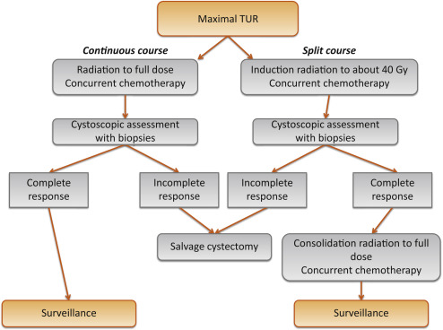
REVIEW
Critical analysis of bladder sparing with trimodal therapy in muscle-invasive bladder cancer: a systematic review.
1980-2013 (Pubmed and Cochrane Database)
Low volume T2
No hydronephrosis
No extensive insitu carcinoma
Eur Urol 2014;66:120- 137.

Slide 51
Review Questions --
What is the 5 year survival for chemo-RT vs. cystectomy?
5 overall year survival for chemo/RT approximately 50-60% (57% in pooled RTOG analysis and MGH analysis), similar to cystectomy.
In general, what is the chance of sparing the bladder if the patient were an operable candidate?
CR rate after treatment is ~70-80% (69% pooled RTOG and 78%-88% in RTOG 0712)
5-yr DSS on the order of 70% (77% in Toronto matched analysis)
Salvage cystectomy rate is 20-30% (21% in pooled RTOG, 29% in MGH), appears to be dropping over time (10-15%)
~25% get NMIBC recurrence
Any benefit to neoadjuvant chemotherapy?
Not for chemoRT (RTOG 8903).
Notes:
--Yes, means that salvage cystectomy is not an option. So this is definitive chemoRT, no need to do interim evaluation
-- multifocal, extensive CIS, incomplete TURBT, poor bladder function, hydronephrosis
-- may not be good candidates but if not candidates for cystectomy may do well with combined chemoradiotherapy.
Consider 5-FU/MMC for patients with decreased renal function,.
--5 overall year survival for chemo/RT approximately 50-60%, similar to cystectomy.
--Bladder sparing successful in approximately 70% at 5 years
--No value of giving chemotherapy before chemo/RT

Slide 52
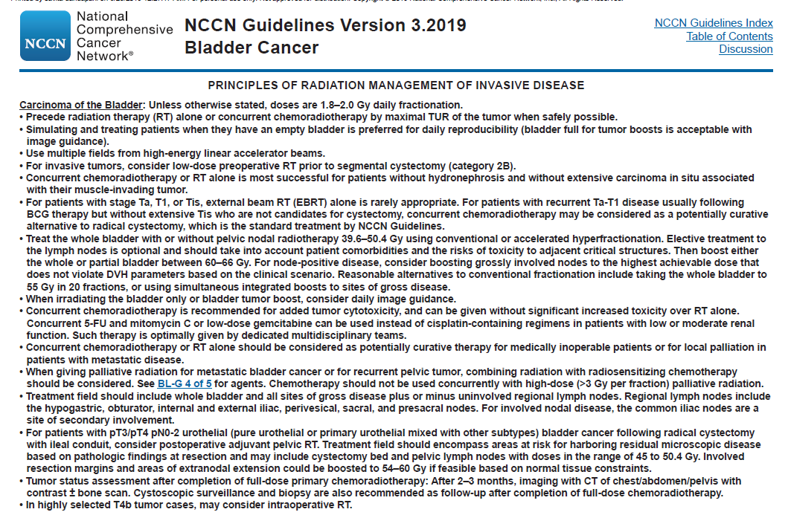
RTOG whole pelvis
BC2001 just whole bladder

Slide 53
Follow-up for bladder sparing patients
How will you follow the patient?
Cystoscopy at 4-6 weeks, then q3 months for two years, and then q6 months yrs 3-5, then qyear
Followup per NCCN: at 2-3 months, imaging with full CT of c/a/p with contrast, w/ or w/o bone scan.
Notes:
--Simulate patient with full and empty bladder in supine position with/without IV contrast. If doing cone down boost method, use empty bladder for whole bladder tx and full bladder for the boost tx.
--→RTOG 0712 approach (for contouring): CTV pelvis/CTV bladder/CTVboost. CTV pelvis is a small pelvic field historically (because of trying to preserve bowel in case of salvage surgery), starting at S2-S2 and extending inferiorly below obturator foramen, CTV bladder is whole bladder, and CTV boost is gross tumor. Used four fields with 2 cm margin on each CTV for the various cone-downs. The fractionation is complicated and may not be needed to get into the nitty gritty, but on this trial would generally deliver 20 Gy to pelvis/then 8 Gy to bladder/then 12 Gy to boost-→break for eval→then 24 Gy to pelvic field (for total doses of 44/52/64 Gy)
--→BC2001 approach (for contouring): PTV=(bladder+extravesical tumor)+1.5 cm for whole bladder // PTV=GTV+1.5 cm for partial bladder high dose target [however, even in partial bladder arm, the whole bladder field is still drawn and gets 80% of rx dose
--→Simple approach would be to just treat whole bladder field (assume no nodes) to 50 Gy, then boost a partial bladder volume to 64 Gy
➔Final doses are either 64 Gy in 2 Gy fx (RTOG, BC2001) or 55 Gy in 2.75 Gy fx
→Chemo regimens include 5-FU/Cis (old RTOG regimens with bid rt), cisplating/paclitaxel (RTOG 0233), 5-FU/MMC (BC2001), weekly gemcitabine (RTOG 0712 experimental)
-→Cystoscopy at 4-6 weeks, then q3 months for two years, and then q6 months yrs 3-5, then qyear.
Followup per NCCN: at 2-3 months, imaging with full CT of c/a/p with contrast, w/ or w/o bone scan.

Slide 54
We rarely see definitive so what about postop?

Slide 55
Baumann et al 2016 – postop Bladder
For pT3 bladder cancers
Swog 8710 showed about 30% localregional failure in pelvis at 5 years
Postop risk groups:
Low risk: pT2 (8% LRF)
Intermediate risk: pT3 and negative margins and >=10LN removed (20% LRF)
High risk: pT3 and positive margins and <10LN removed (40% LRF)
Postop bladder xrt not routinely done because 1980s xrt had lots of toxicity – probably bowel/bone marrow?
5yr OS for T2 is ~60% but only 10-40% for T3+

Slide 56
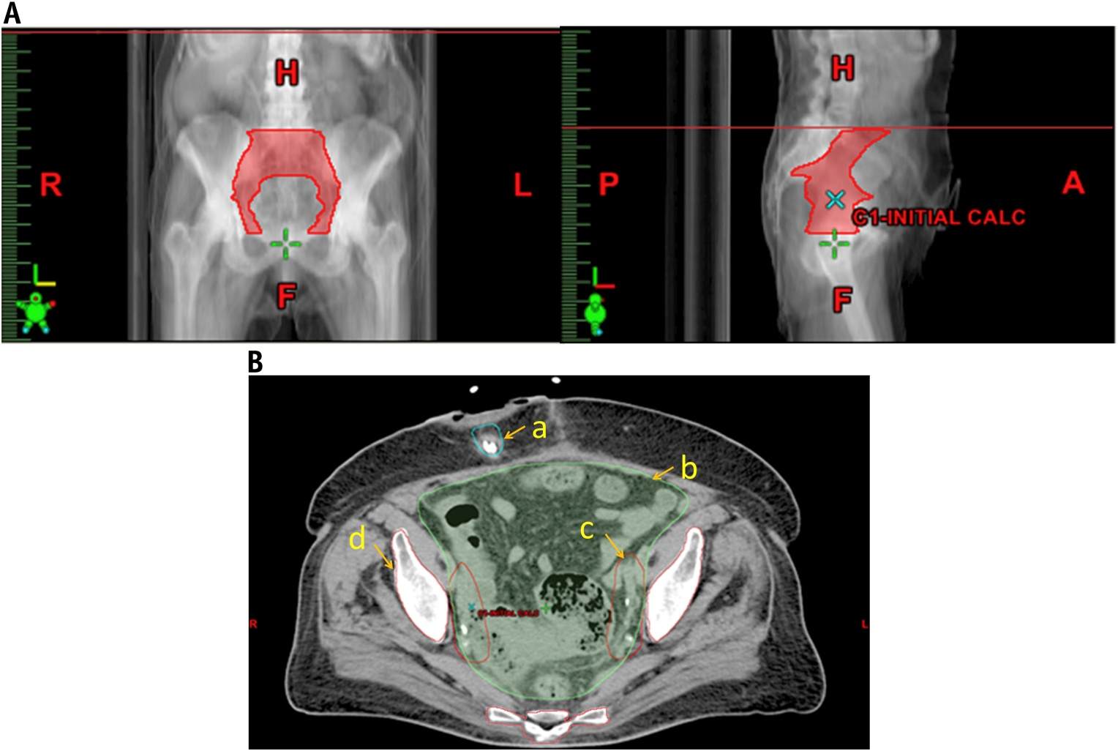

Baumann et al IJROBP 2016 (CTV LN, PTV5-7mm)
Fig. 4
Distal common iliac (~L5)
External iliac
Internal iliac
Presacral
obturator
International Journal of Radiation Oncology • Biology • Physics 2016 96, 78-86DOI: (10.1016/j.ijrobp.2016.04.032)
Copyright © 2016 Elsevier Inc. Terms and Conditions
Notes:
(A) Anterior–posterior and lateral projections of the pelvic node clinical target volume. (B) Representative axial computed tomography slice showing the (a) urinary diversion, (b) bowel space, (c) nodal clinical target volume, and (d) pelvic bone contours.

Slide 57
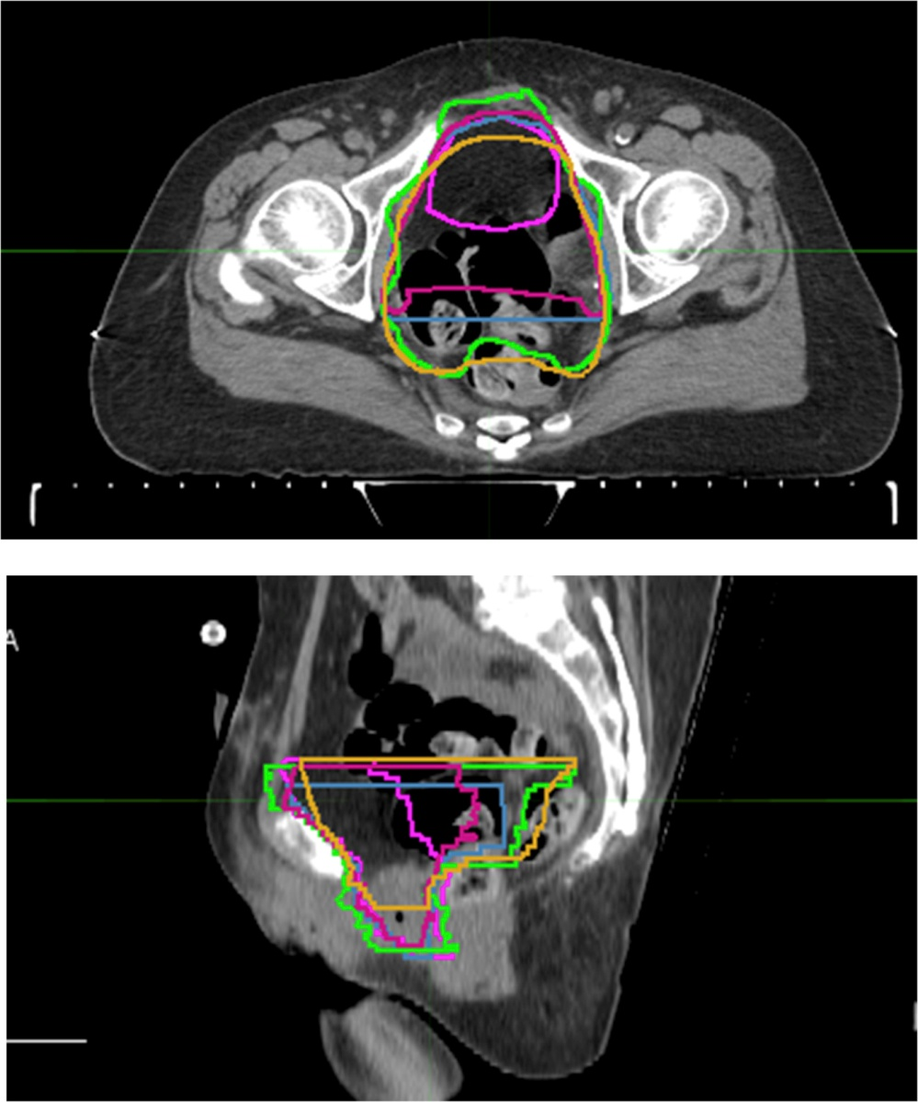
Fig. 1
International Journal of Radiation Oncology • Biology • Physics 2016 96, 78-86DOI: (10.1016/j.ijrobp.2016.04.032)
Copyright © 2016 Elsevier Inc. Terms and Conditions
Notes:
Initial investigator contours for the cystectomy bed superimposed. Each panel member's contours are assigned a different color.

Slide 58
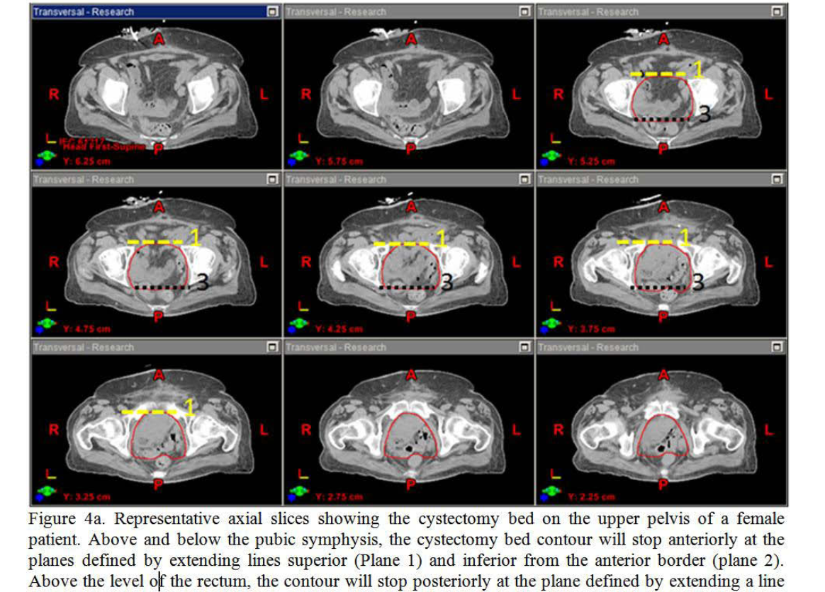

Slide 59
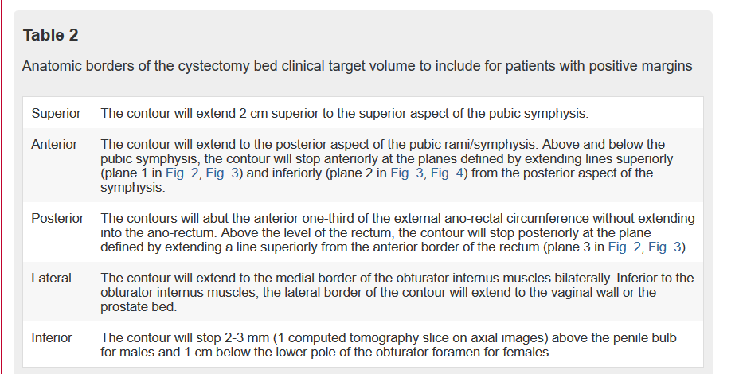
Baumann – cystectomy bed only if +ve margins

Slide 60
Zaghloul et al Jama surgery 2018/2019
Postop bladder
Originally phase III but changed to phase II (dropped the sequential chemo xrt)
Chemo xrt vs chemo alone
Primary: LRFS
70yo
T3b, grade 3, +ve LN
Negative margins
91% >= T3b
45Gy/1.5Gy BID (TO PELVIC LYMPH NODES AND CYSTECTOMY BED! BOTH)
Cis/gem
~50% urothelial/~50% squamous
2yr LRFS 96% (+XRT) vs. 69% (DFS 70% vs. 60%) (OS 70% vs. 60%)
7% grade 3 GI toxicity

Slide 61
NRG GU001
RANDOMIZED PHASE II TRIAL OF POSTOPERATIVE ADJUVANT IMRT FOLLOWING CYSTECTOMY FOR pT3/pT4 UROTHELIAL BLADDER CANCER
pT3/T4, pN0-N2 (highest risk if <10LN dissected)
50.4Gy/28fx (lymph nodes if margins negative (add cystectomy bed if margins positive)

Slide 62
Post TURBT – consider CRT for high risk T1 (Weiss et al JCO 2006)
Single institution, Germany (their institution policy to offer CRT since 1982 for “high risk” features)
TURBT – T1 high risk (CRT as alternative to intravesical tx or early cystectomy)
High risk features:
T1 grade 3
T1 grade ½ + Tis multifocal
Multiple recurrences
Tumor >5cm
80% kept bladder, 70% delighted with urinary sx
5yr LF 20%, 10yr LF 30% (so can potentially save some bladders)

Slide 63
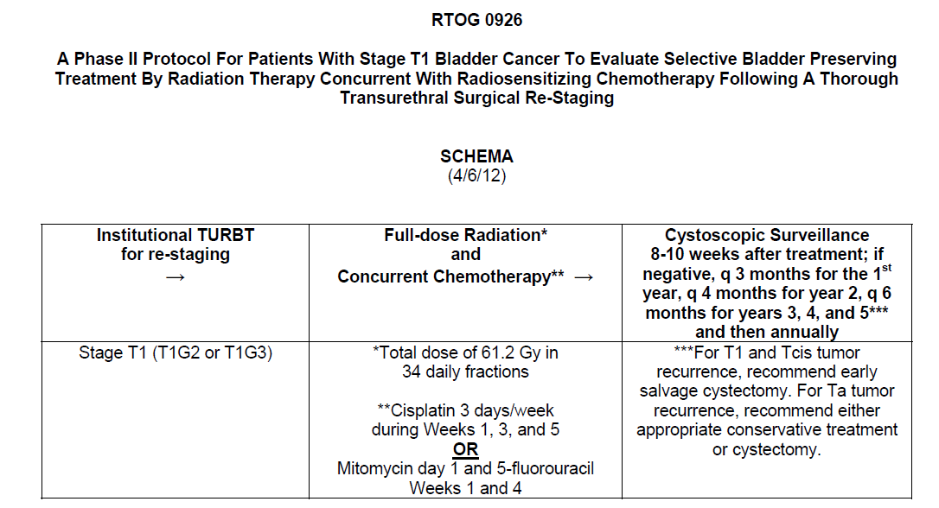
Radiation Option for T1 bladder

Slide 64
Biomarkers – MRE11 (?? DNA damaging signaling protein)
Samples from BCON and BC2001 (Walker et al IJROBP 2019) could not validate MRE11 as a biomarker for CRT bladder preservation
MRE11 high expression better outcomes in another study (Choudhary et al 3yr CSS 43% vs. 69%) for bladder preservation
So far no MRE11 and cystectomy correlation
Unusual that high expression would predict better response to radiation
RTOG pooled analysis thought MRE11 nuclear to cytoplasmic ratio more important (disease specific mortality 41% if N/C <1.49 vs. 21% if N/C >1.49, more nuclear expression of MRE11 did better?)
Other biomarkers microRNA: miR-23a, miR-27a (associated with complete response to CRT bladder preservation) (Meng, Chakravarti et al 2018)

Slide 65
Out of 465 eligible pts, tissue was available and MRE11 N/C
determined for 135. Analyzable pts were less likely to be white (
P
Z
0.0001) and more likely to be T2 (
P
Z
0.0003). Median MRE11 N/C was
2.41 (min-max: 0.69-6.03). Pts with MRE11 N/C
1.49 (lower quartile)
were associated with significantly higher DSM (HR
Z
2, 95% CI: 1.1, 3.8,
P
Z
0.03). The 4-year DSM was 41% for pts with MER11 N/C
1.49 vs.
21% for pts with MER11 N/C was
>
1.49. MRE11 N/C was not associated
with OS or BIS.
Conclusion:
AQUA analysis allows precise measurement of this marker in
tissue samples. Low expression of MRE11 N/C (
1.49) is associated with
significantly higher DSM. This adds further evidence of MRE11 as a
potential RT response biomarker for selection of pts most likely to respond
to bladder-sparing CRT.
Supported by NCI grants U10CA180868, U10CA180822,

